Slide 1
Constitutional Reform

Slide 2
The current environment
Since 1996 Aboriginal policy and involvement of Aboriginal peoples in the development of policy and implementation of programs and initiatives to help our people has been in decline.
Progressive denial and removal of Aboriginal influence, control and involvement has been an active agenda.
  Removal of a National Voice
  Negative use of s.51(26)
    Hindmarsh
    Northern Territory Intervention
    Wik (Mabo 2)
  Income Management
  Indigenous Advancement Strategy

Slide 3
2017
At the same time we cannot deny the advances.
The number of doctors, nurses, lawyers, engineers etc. etc.
The significant land and asset holdings across the country
The institutions that now exist.
But we also cannot deny the challenges in front of us to make good on the advances to date. But it has been patchy, geographically and sectorially.
Health, Housing, Education, Employment and Law and Justice remain as significant challenges.
Land Rights, Culture and Heritage protection and Wealth eludes us.
A better life for our children remains the objective.

Slide 4
ULURU STATEMENT FROM THE HEART
We, gathered at the 2017 National Constitutional Convention, coming from all points of the southern sky, make this statement from the heart:
Our Aboriginal and Torres Strait Islander tribes were the first sovereign Nations of the Australian continent and its adjacent islands, and possessed it under our own laws and customs. This our ancestors did, according to the reckoning of our culture, from the Creation, according to the common law from ‘time immemorial’, and according to science more than 60,000 years ago.
This sovereignty is a spiritual notion: the ancestral tie between the land, or ‘mother nature’, and the Aboriginal and Torres Strait Islander peoples who were born therefrom, remain attached thereto, and must one day return thither to be united with our ancestors. This link is the basis of the ownership of the soil, or better, of sovereignty. It has never been ceded or extinguished, and co-exists with the sovereignty of the Crown.
How could it be otherwise? That peoples possessed a land for sixty millennia and this sacred link disappears from world history in merely the last two hundred years?
With substantive constitutional change and structural reform, we believe this ancient sovereignty can shine through as a fuller expression of Australia’s nationhood.
Proportionally, we are the most incarcerated people on the planet. We are not an innately criminal people. Our children are aliened from their families at unprecedented rates. This cannot be because we have no love for them. And our youth languish in detention in obscene numbers. They should be our hope for the future.
These dimensions of our crisis tell plainly the structural nature of our problem. This is the torment of our powerlessness.
We seek constitutional reforms to empower our people and take a rightful place in our own country. When we have power over our destiny our children will flourish. They will walk in two worlds and their culture will be a gift to their country.
We call for the establishment of a First Nations Voice enshrined in the Constitution.
Makarrata is the culmination of our agenda: the coming together after a struggle. It captures our aspirations for a fair and truthful relationship with the people of Australia and a better future for our children based on justice and self-determination.
We seek a Makarrata Commission to supervise a process of agreement-making between governments and First Nations and truth-telling about our history.
In 1967 we were counted, in 2017 we seek to be heard. We leave base camp and start our trek across this vast country. We invite you to walk with us in a movement of the Australian people for a better future.

Slide 5
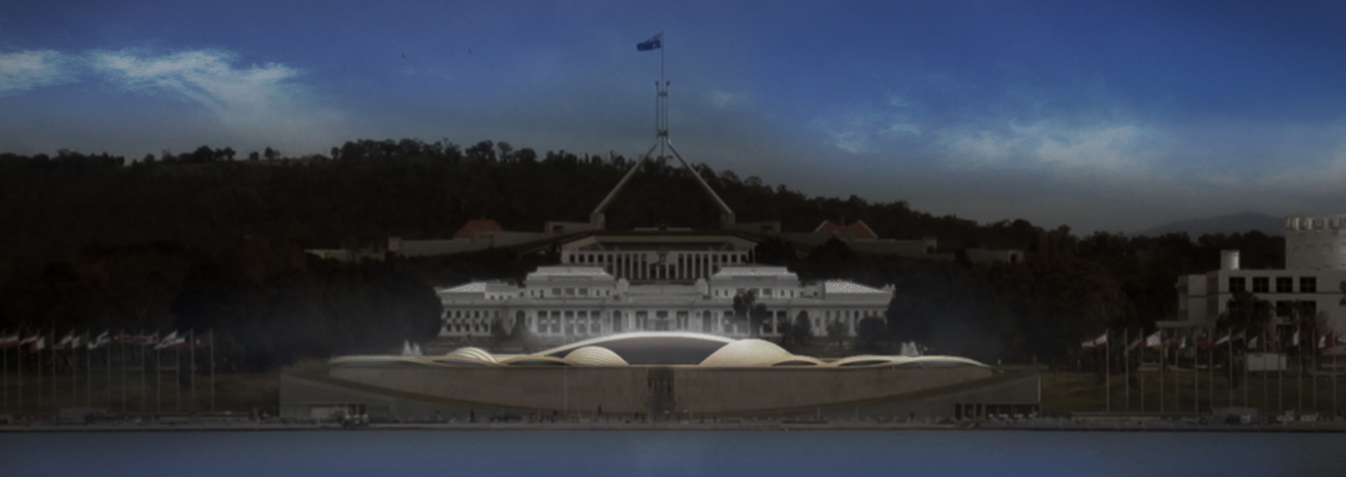

Slide 6
GUIDING PRINCIPLES
Does not diminish Aboriginal sovereignty and Torres Strait Islander sovereignty.
Involves substantive, structural reform.
Advances self-determination and the standards established under the United Nations Declaration on the Rights of Indigenous Peoples.
Recognises the status and rights of First Nations.
Tells the truth of history.
Does not foreclose on future advancement.
Does not waste the opportunity of reform.
Provides a mechanism for First Nations agreement-making.
Has the support of First Nations.
Does not interfere with positive legal arrangements.

Slide 7
The path has been along one from the 1930’s there have been call, movements and numerous attempts…...
1930s: Calls for the Commonwealth Government to be given specific power under the Constitution in relation to Indigenous affairs.
In 1926, David Unaipon called for the formation of a separate Aboriginal Territory, ‘Centralia’, to ensure increased Indigenous autonomy and representation.
In 1927, Fred Maynard wrote a letter to the New South Wales Premier asking for equal citizenship rights and for the control of Indigenous affairs to be transferred to an Indigenous board so Aboriginal people could supervise their own affairs.
In 1933, Joe Anderson, otherwise known as the great King Burraga, chief of the Thurawal tribe near Sydney, petitioned the Prime Minister for representation in federal parliament.
In 1937 William Cooper echoed the call for Indigenous representation in parliament. He petitioned King George V.
In 1949 Sir Pastor Doug Nicholls wrote to then Prime Minister, Ben Chifley, arguing for Indigenous representation in federal parliament.
In 1963, the Yirrkala bark petitions pleaded for the government to listen to Yolngu people before making decisions about their land and their lives.
In 1967 the Constitution was amended to delete section 127 and amend s 51 (26). The Yes vote was over 90% of Australians.

Slide 8
In 1983 Senate Standing Committee on Constitutional and Legal Affairs recommends that the Constitution be amended to facilitate agreement making between Indigenous peoples and the Australian state.
In 1988 Galarrwuy Yunupingu presented the Barunga Statement to Prime Minister Hawke calling for a treaty to recognise Indigenous rights to self-determination and self-management. The Barunga Statement called for Aboriginal control, freedom and respect, and for a national elected Aboriginal and Islander organisation to oversee Aboriginal and Islander affairs.
In 1988 the Individual and Democratic Rights Advisory Committee in the Constitution Commission’s Report advised that ‘the Preamble should acknowledge the historical truth of the settlement of Australia by Europeans in 1788. It is appropriate to recognise in the Preamble that prior to the arrival of European settlers Australia was owned by the Aboriginal people. Such recognition in the Constitution would be an act of good faith and symbolic importance in furthering reconciliation between Aboriginal and non- Aboriginal Australians’.
In 1992 High Court hands down its decision in Mabo v Queensland (No 2), holding that native title survived the acquisition of sovereignty by the British
In 1992-1995 the response to Mabo is fashioned by the Keating Government and amongst other things, a ‘Social Justice Package’ is devised; Indigenous groups and organisations propose the package should include a range of constitutional reforms; the Keating Government loses office before the package can be implemented

Slide 9
In 1999 a referendum is held proposes to make Australia a republic and to insert a preamble recognising Indigenous people; both referendum questions are defeated.
In 2000 the Council for Aboriginal Reconciliation recommends several constitutional reforms, including the insertion of a preamble recognising Indigenous people, the deletion of s 25, the insertion of a section making it unlawful to discriminate on racial grounds, and the amendment of s 51(xxvi) so that it only permits the making of ‘beneficial’ race-based laws; the recommendations are not adopted by Parliament.
In 2003 the Senate Legal and Constitutional Affairs Committee recommends the insertion of a preamble recognising Indigenous peoples, the deletion of s 25, and the amendment of s 51(xxvi) so that it only permits race-based laws for the benefit of any particular race
In 2007 Former Prime Minister John Howard announced that his Government was committed to holding a referendum on constitutional recognition, which was also supported by the Opposition.

Slide 10
In 2008 Former Prime Minister Kevin Rudd pledged his support for recognition after receiving a communique on behalf of the Yolngu and Bininj clans in Arnhem calling for the Government to ‘work towards constitutional recognition of our prior ownership and rights’.
In 2008 the 2020 Summit recommends constitutional reform concerning Indigenous peoples elements of which are endorsed by the Labor Government
In 2010-12 Former Prime Minister Julia Gillard commissioned an Expert Panel to inquire into the recognition of Aboriginal and Torres Strait Islander peoples in the Constitution. The Expert Panel held more than 250 consultations across Australia and received some 3,500 submissions and made recommendations for a statement of recognition in a new head of power to make laws for Aboriginal and Torres Strait Islander peoples, deletion of s 25, insertion of a non-discrimination clause and a recognition of Indigenous languages.
In 2013 Parliament passed the Aboriginal and Torres Strait Islander Peoples Recognition Act 2013, which acknowledged Aboriginal and Torres Strait Islander peoples as the first occupants of Australia.
In 2014 a review panel convened under the Aboriginal and Torres Strait Islander Peoples Recognition Act recommended that the Government proceed towards a referendum provided certain preconditions were met.
In 2015 the Parliamentary Joint Select Committee on Constitutional Recognition of Aboriginal and Torres Strait Islander Peoples’ final report recommended that a referendum be held on constitutional recognition, and set out a range of options for change.
In 2015 Prime Minister Malcolm Turnbull announced establishment of a Referendum Council to oversee significant national consultations, including a series of specific Indigenous consultations, on recognition.

Slide 11
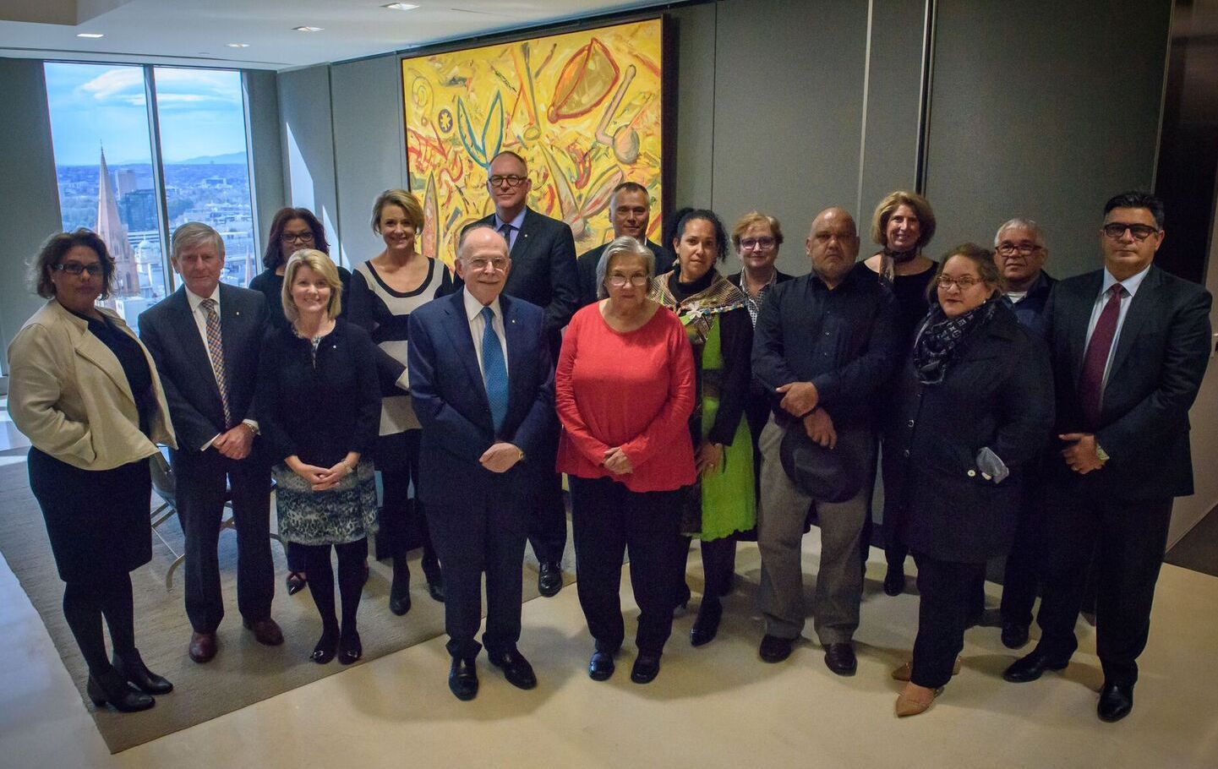
Referendum Council

Slide 12
Chronology
2010 December Expert Panel established.
2012 January Expert Panel Report
2012 November Joint Select Committee established (43rd).
2013 March Recognition Act 2013.
2013 June Joint Select Committee Progress Report (43rd)
2013 December Joint Select Committee established (44th)
2014 July Joint Select Committee Interim Report (44th)
2014 September Review Panel Report
2014 October Joint Select Committee Progress Report (44th)
2015 June Joint Select Committee Final Report (44th)
2015 July Kirribilli Meeting
2015 December Referendum Council established
2017 June Referendum Council reports.

Slide 13
Referendum Council - Membership
Co-Chairs : Pat Andersen & Mark Leibler
Megan Davis
Tanya Hosch
Noel Pearson
Dalassa Yorkston
Galarrwuy Yunupingu
Stan Grant (resigned)
Mick Gooda (resigned)
Andrew Demetriou
Murray Gleeson
Kristina Keneally
Jane McAloon
Michael Rose
Natasha Stott Despoja
Amanda Vanstone

Slide 14
Role
The Council will report to the Prime Minister and the Leader of the Opposition on:
  outcomes of national consultations and community engagement about constitutional recognition, including indigenous-led consultations;
  options for a referendum proposal,
  steps for finalising a proposal, and
  possible timing for a referendum; and
  constitutional issues.

Slide 15
Referendum Council – Indigenous Consultations
  In addition to ensure that all Australians have an opportunity to have a say there will be
  online consultations on a digital platform,
  a public submissions process, and
  direct engagement with a number of stakeholders.

Slide 16
Referendum Council – Indigenous Dialogues
The objective is to seek the views of Aboriginal and Torres Strait Islander representatives on options that:
  are likely to be supported by Indigenous people and
  are likely to succeed at a referendum.

Slide 17
Referendum Council – Indigenous Dialogues
  Three Indigenous Leadership meetings
  II. Twelve Regional First Nations Dialogues
  III. A National Indigenous Convention

Slide 18
Indigenous Steering committee
2016 June - Broome Leaders Forum
2016 June - Thursday Island Leaders Forum
2016 July - Melbourne Leaders Forum
2016 November Leaders Meeting Sydney
2016 November Leaders Meeting Melbourne
2016 November Melbourne Trail Dialogue

Slide 19
Regional Dialogues
100 invited delegates
60 - Traditional owners 20 – Organisation 20 - Individuals
Region Host Organisation
2 Regional Co Convenors
5 Regional Workshop Leaders
2 days spread over 3 days
10 delegates to Uluru
Deliberative Structured Agenda
Record of Meeting

Slide 20
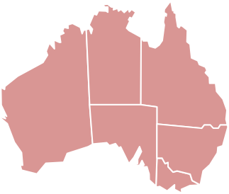
Regional First Nations Dialogues
Darwin
Torres Strait
Broome
Cairns
Alice
Springs
Brisbane
Perth
Dubbo
Sydney
Adelaide
Canberra
Melbourne
Hobart

Slide 21
Regional Dialogues
Hobart 9-11 December 2016
Broome 10-12 February 2017
Dubbo 17-19 February 2017
Darwin 22-24 February 2017
Perth 3-5 March 2017
Sydney 10-12 March 2017
Melbourne 17-19 March 2017
Cairns 24-26 March 2017
Alice Springs 31 Mar - 2 Apr 2017
Adelaide 7-9 April 2017
Brisbane 21-23 April 2017
Thursday Island 5-7 May 2017
Canberra 10 May 2017

Slide 22
Regional Dialogues – Five / Six Proposals
A statement of acknowledgement;
The power to make laws for Aboriginal and Torres Strait Islander peoples
A constitutional prohibition against racial discrimination
An Indigenous voice in Parliament;
Agreement making
Deleting section 25

Slide 23
National First Peoples Conventions
Uluru

Slide 24
National Convention
23-26 May 2017 at ULURU
Consider the outcomes from the 13 Regional Dialogues
Seek some consensus or agreement on the proposals
Identify and agree on the headline issues
Next steps

Slide 25
What Happened
The dialogues almost universally identified lack of voice, exclusion and powerlessness as a primary issue.
The impact of the many Government “imposed solutions” over the last two decades was a constant theme.
All agreed on the issues but the path, strategy and objective differed.
Identity be that expressed as sovereignty, language, culture and heritage or nations was a constant issue.
Discussion was passionate and heart felt.

Slide 26
What Happened
The Convention prioritised the ways forward
We want a voice
We want agreements, Treaties to resolve matters, provide more certainty and a way forward.
It also voiced concern in regard to some proposals.
Impact on sovereignty
Changing the head of power will change nothing
A prohibition on Racial Discrimination can be manipulated

Slide 27
Impact on health
The Uluru Statement is very much in alignment with the Theme of this gathering.
Renewal, Unity and Strength
Health is a fundamental issue, and inextricably linked to the many other social and physical determinants.
What people yearned was for a real voice and influence in effecting real and substantive change.

Slide 28
REFERENDUM COUNCIL
Final Report
to the
Prime Minister and Leader of the Opposition
By 30 June 2017

Slide 29

Five Hurdles
1
2
3
4
5
First Nations People
This is the crucial first hurdle.
PM
This is the crucial second hurdle.
PARTY ROOM
The Party Room is the most difficult hurdle of all.
PARLIAMENT
PEOPLE
As difficult as the Referendum hurdle is, it is the lowest of the 5 hurdles. Provided a bipartisan position emerges out of Parliament.

Slide 30
The Facts
155 – Proposals for referenda
44 – Referenda that actually got to the people
8 – Number of successful referendums
1977 – The last successful referendum

Slide 31
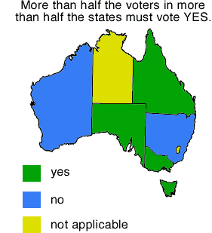
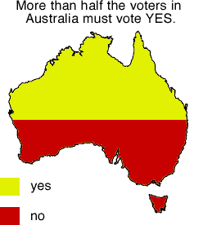

Slide 32
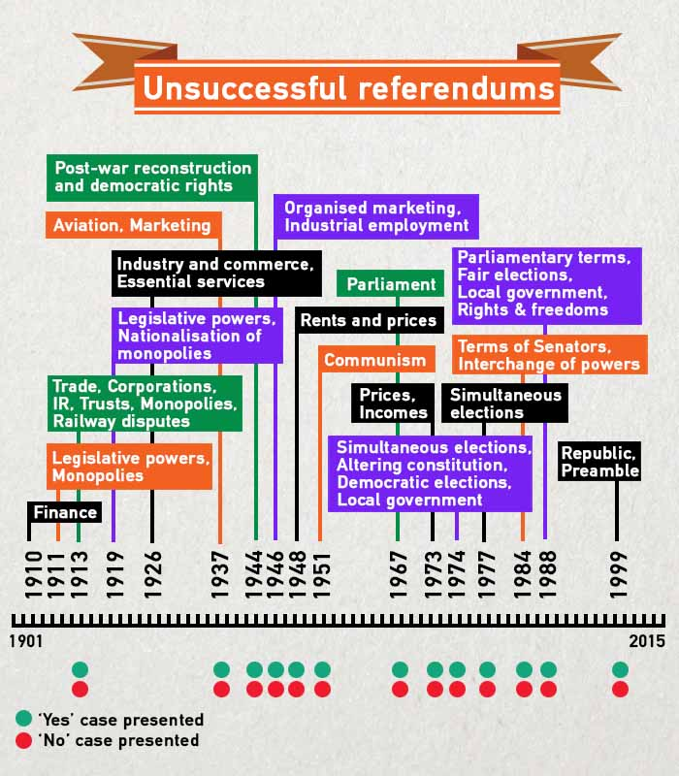
ABC Fact Check

Slide 33
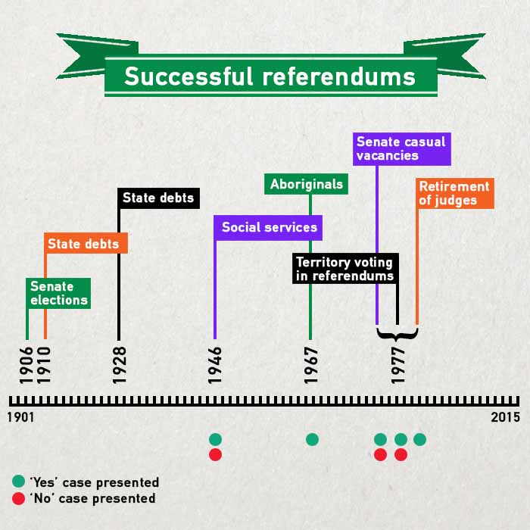
ABC Fact Check

Slide 34
The ULURU Statement is one of hope and a focus on the future
A call for unity
A call to all for a better life,
A call for honest, fair and truthful relationships
A call to all to join this journey

