Slide 1

Working in partnership in Aboriginal Health
Elizabeth Koff
Secretary NSW Health
AH&RMC Meeting Ground Workshop
15 June 2017

Slide 2
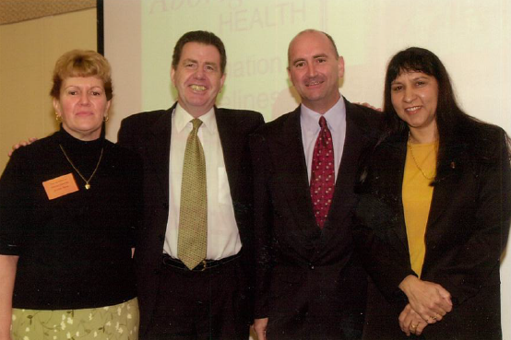
Partnership signing in 2001

Slide 3



Slide 4
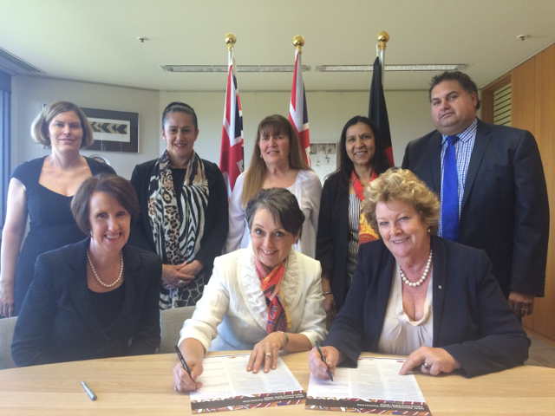
Partnership signing in 2015

Slide 5
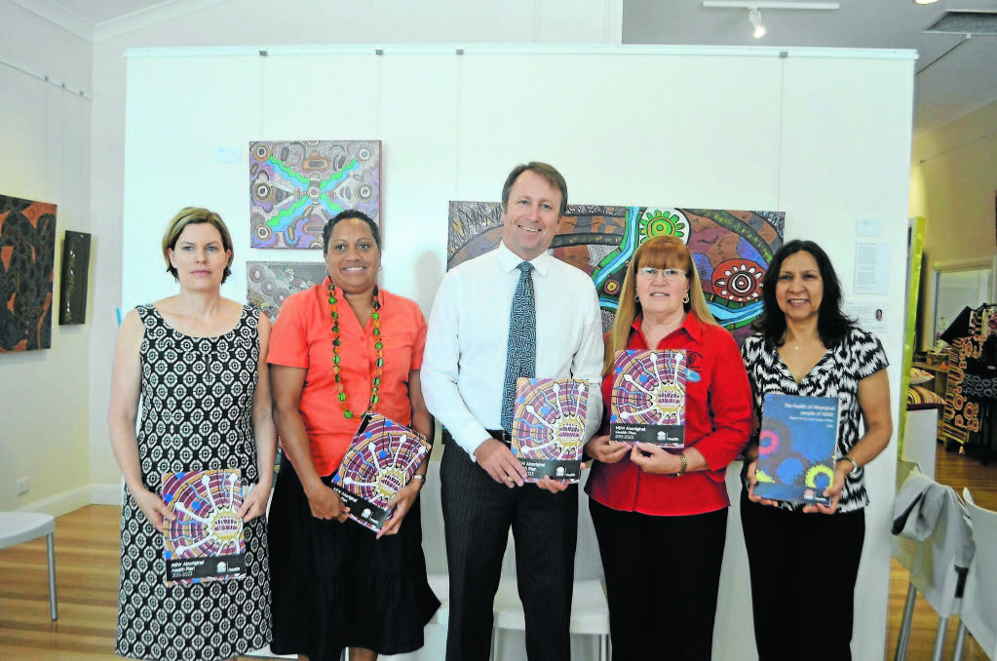
NSW Aboriginal Health Plan 2013-2023
Vision: Health equity for Aboriginal people
Goal: To work in partnership with Aboriginal people to achieve the highest level of health possible

Slide 6
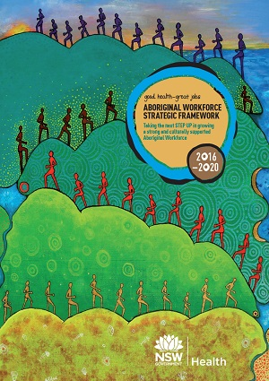
Aboriginal Workforce Strategic Framework
Key priority areas:
  lead and plan Aboriginal workforce development
  build cultural understanding and respect
  attract, recruit and retain Aboriginal staff
  develop the capabilities of Aboriginal staff
  work with others to achieve workforce priorities
  track our achievements and improve results

Slide 7
Working in partnership in Aboriginal Health
Dr Kerry Chant
Chief Health Officer and Deputy Secretary Population and Public Health
AH&RMC Meeting Ground Workshop
15 June 2017

Slide 8
Positioning the sector
Aboriginal NGO program funding is non-contestable
3 year funding agreements
Clinically focused, electronically extractable, outcomes focused KPIs
$23 million in 2016/17 to 42 services across 44 sites
Increased funding to the sector
  7 additional services
  $1.6 million population health enhancement
Greater flexibility of funding complements Commonwealth and LHD investments

Slide 9
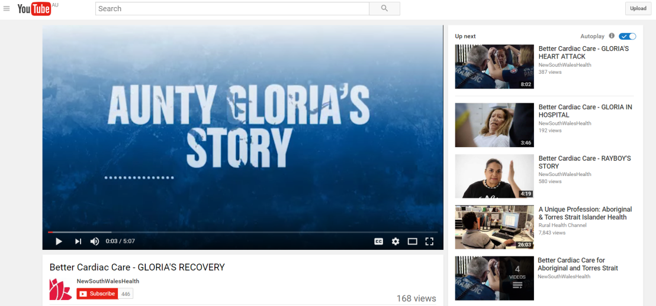
Better Cardiac Care
Implementation Committee and Aboriginal Advisory Group
Suite of cardiac care videos
Medicare data linkage study
Aboriginal Health Assessment Template- MBS 715

Slide 10
Working in partnership in Aboriginal Health
Geraldine Wilson- Matenga
Director, Centre for Aboriginal Health
AH&RMC Meeting Ground Workshop
15 June 2017

Slide 11

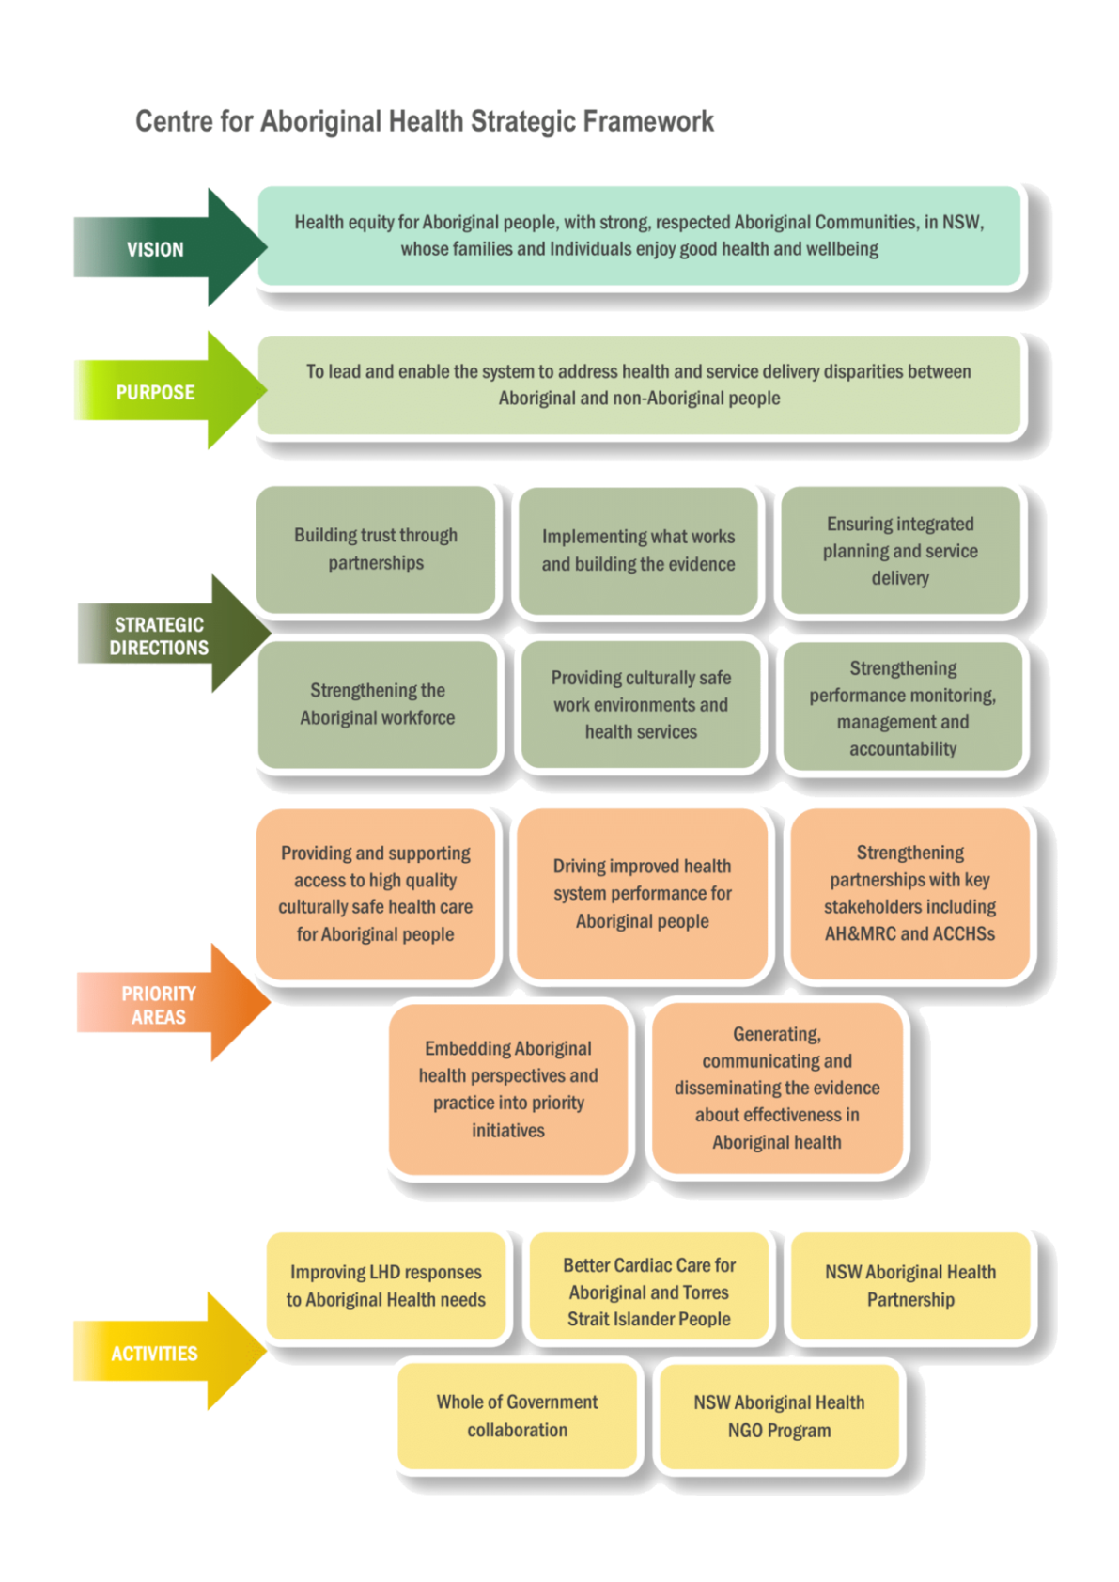


Slide 12
AH&MRC funding agreement
Capacity and capability building for member services
Policy leadership, influence and reform
Health Ethics

Slide 13

System Performance
Aboriginal Health Impact Statement
Aboriginal Health Dashboards for LHDs/ SHNs
Focused discussions between the Ministry and LHDs/SHNs

Slide 14
Questions?

